Slide 1


Coursera & IBM Capstone project The battle of Neighborhoods
Identifying the best location to open a new Italian restaurant in New York City
By Tevin Richard

Slide 2
Introduction
Entrepreneurs are constantly attempting to start businesses for the purpose of deriving an income stream and establishing a successful business empire. One of the largest challenges entrepreneurs face when starting a new business is finding the optimal location for starting up.
Location is key when starting a business since an ideally situated business will receive high customer traffic which could potentially translate into profitability. Furthermore, it is important to start a business in a location where the product or service you intend to offer is not readily available. This implies strategically starting up in an area that is not rife with competition, thereby allowing you to meet the needs and/or wants of that population. By strategically opening a business in an area that has low levels of competition, it can be assumed that you will not have to keep up with competitive prices of the already established enterprises which would drastically increase your businesses’ probability of success.
The next problem is to determine which Borough and neighborhood in NYC would be the most ideal location to purchase/lease a property for the purpose of starting a business.

Slide 3
Problem Questions
The project was structured to answer the following key problem questions:
Which borough in NYC would be the best borough to open an Italian restaurant? (Based on least competition)
Which location has the highest number of Italian restaurants?
Which Neighborhood would be the best Neighborhood to open an Italian restaurant? (Based on least competition)
Who would be the top 5 most competitive Italian restaurants in NYC that Raymond would have to compete with? (Based on customer ratings)
Which Italian restaurant would represent the lowest level of competition?
What would be the best locations (street names) to open an Italian restaurant?

Slide 4
Data Selection
The following data was utilized for the purposes of this project
New York City data
This data set will be used to obtain information for the list of all Boroughs and Neighborhoods in NYC, together with their respective latitudes and longitudes.
Source: This data can be obtained at the following link.
Italian Restaurants Data
The data for all NYC Italian restaurants, including their stats (likes, ratings and tips) will be extracted using the Foursquare API..
Source: Foursquare API

Slide 5
Methodology
The following methodology was implemented for the completion of this project:
Import the required libraries need to complete the project
Retrieve the NYC location data containing latitude and longitude for each NYC Borough and Neighborhood.
Determine the best borough by identifying the smallest borough and one that ideally suited for dining and night life.
Retrieve the locations of all Italian restaurants using the Foursquare API
Group the data according the number of Italian restaurants per neighborhood. Identify the neighborhoods with the least number of Italian restaurants.
Extract the statistics for each Italian restaurant in the selected borough using the Foursquare API.

Slide 6
Methodology
The following methodology was implemented for the completion of this project:
7. Apply the K-Means clustering algorithm to cluster each Italian restaurant in the best borough. Use clusters to identify Italian restaurants that represent high and low levels of competition.
8. Group the neighhoods according to average ratings of Italian restaurants to find the highest and lowest rated Neighborhoods for Italian restaurants.
9. Choose the best nationhood to open a new Italian restaurant based on lowest levels of competition.

Slide 7
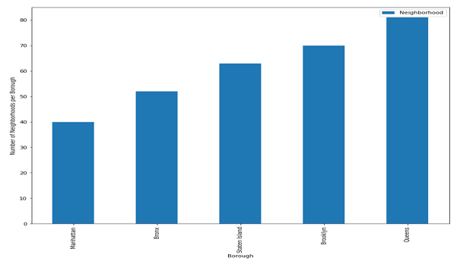
Results
Count of Neighborhoods per NYC Borough
Total of 306 neighborhoods in NYC
Lowest number of neighborhoods – Manhattan
Highest number of neighborhoods - Queens

Slide 8
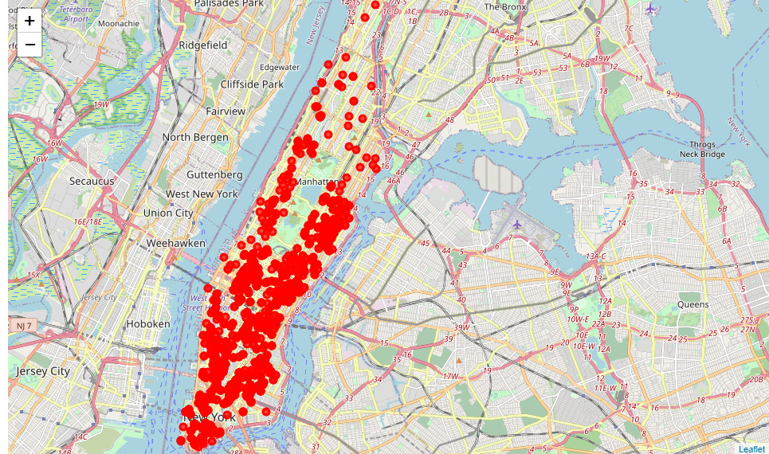
Results
Visual representation of Italian restaurants distribution in Manhattan NYC
Each marker represents an Italian restaurant
Total of 1493 Italian restaurants in Manhattan, NYC

Slide 9
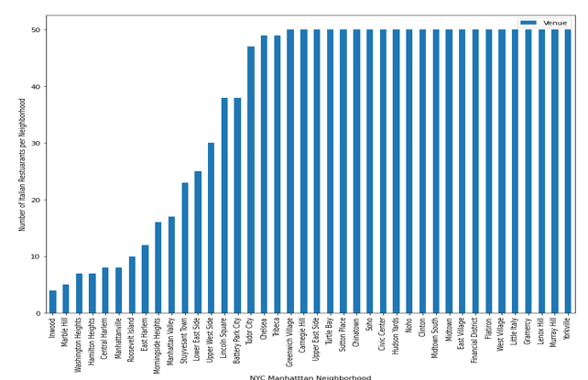
Results
Distribution of Italian Restaurants per neighborhood in Manhattan, NYC.
Inwood has the lowest number of Italian restaurants – 4
22 Neighborhoods each containing 50 Italian restaurants

Slide 10
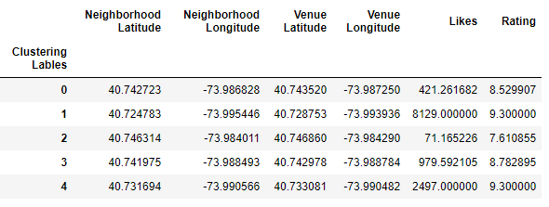
Results
K-Means clustering algorithm centroids:
Cluster 0 - Contains low likes & highly rated Italian restaurants
Cluster 1 - Contains highly liked & highly rated Italian restaurants
Cluster 2 - Contains low likes & lowly rated Italian restaurants
Cluster 3 - Contains medium liked and highly rated Italian restaurants
Cluster 4 - Contains highly liked and highly rated Italian restaurants

Slide 11
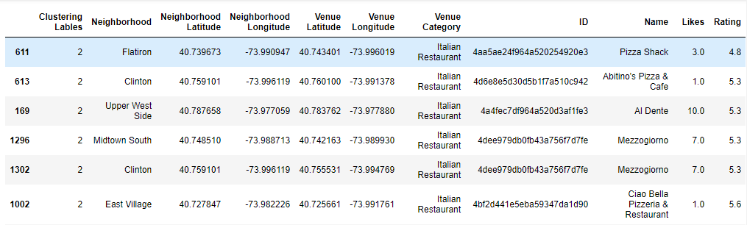
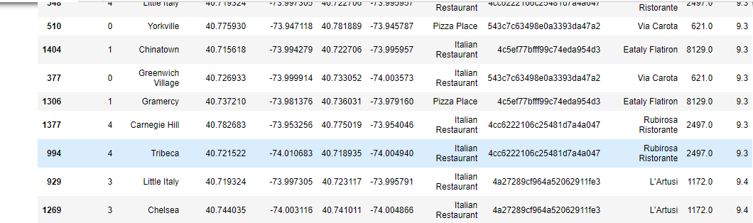
Results
Lowest rated Italian Restaurant in NYC, Manhattan:
Name: Pizza Shack
Rating: 4.8
Likes: 3.0
Neighborhood: Flatiron
Highest rated Italian Restaurant in NYC, Manhattan:
Name: L’Artusi
Rating: 9.4
Likes: 1172
Neighborhood: Chelsea, Little Italy

Slide 12
Results
Lowest rated Italian Restaurant in NYC, Manhattan:
Name: Pizza Shack
Rating: 4.8
Likes: 3.0
Neighborhood: Flatiron
Highest rated Italian Restaurant in NYC, Manhattan:
Name: L’Artusi
Rating: 9.4
Likes: 1172
Neighborhood: Chelsea, Little Italy

Slide 13
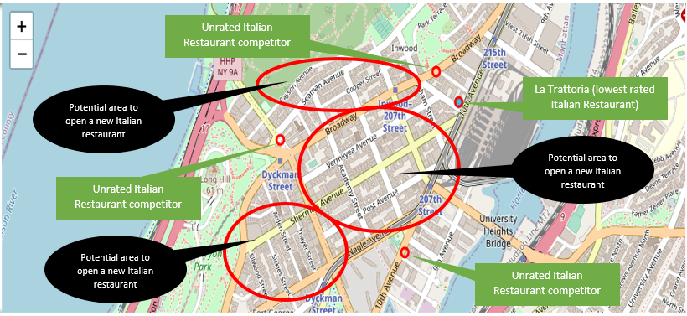
Results
Best Neighborhoods 1 - Inwood

Slide 14
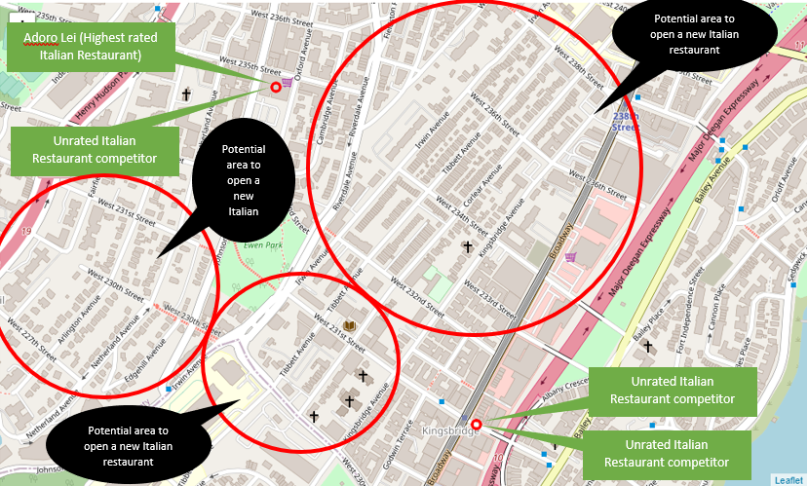
Results
Best Neighborhoods 2 – Marble Hill

Slide 15
Results – Answers to problem questions
1. Which borough in NYC would be the best borough to open an Italian restaurant? (Based on least competition)
Answer : Manhattan
2. Which location has the highest number of Italian restaurants?
Answer: The following Neighborhoods each have the highest number of Italian restaurants (50 restaurants):
Greenwich Village
Carnegie Hill
Upper East Side
Turtle Bay
Sutton Place
Chinatown
Soho
Civic Center
Hudson Yards
Noho
Clinton
Midtown South
Midtown
East Village
Financial District
Flatiron
West Village
Little Italy
Gramercy
Lenox Hill
Murray Hill
Yorkville

Slide 16
Results – Answers to problem questions
3. Which Neighborhood(s) would be the best Neighborhood to open an Italian restaurant? (Based on least competition)
Answer: Inwood and Marble Hill
4. Who would be the top 5 most competitive Italian restaurants in NYC that Raymond would have to compete with? (Based on customer ratings)
Answer: Top 5 rates Italian restaurants in NYC, Manhattan are (in descending order):
1. L’Artusi (Rating = 9.4)
2. Rubirosa Ristorante (Rating = 9.3)
3. Eataly Flatiron (Rating = 9.3)
4. Via Carota (Rating = 9.3)
5. Ristorante (Rating = 9.3)
5. Which Italian restaurant would represent the lowest level of competition?
Answer: The Italian Restaurant in NYC, Manhattan that represents the lowest level of competition (based on customer ratings is):
Pizza Shack (Rating = 4.8)

Slide 17
Results – Answers to problem questions
6. What would be the best locations (street names) to open an Italian restaurant?
Answer: The following are the best proposed locations for opening an Italian restaurant within the best identified neighborhoods:
Inwood best proposed locations:
Broadway
Vermilyea Avenue
Post Avenue
Academy Street
Payson Avenue
Seaman Avenue
Cooper Street
Marble Hill best proposed locations:
West 236th Street
West 238th Street
Cambridge Avenue
Irwin Avenue
Tibbett Avenue
Corlear Avenue
Kingsbridge Avenue
Arden Street
Thayer Street
Sickles Street
Ellwood Street
Sherman Avenue
West 234th Street
West 233rd Street
Werst 232nd Street
West 231st Street
West 230th Street
Arlington Avenue
West 227th Street
Edgehill Avenue
Netherland Avenue

Slide 18
Conclusion
The results and analysis revealed that the best locations for opening a new Italian restaurant are:
NYC, Manhattan – Inwood
NYC, Manhattain – Marble Hill
These neighborhoods have the lowest levels of competition and therefore will have the lowest barriers to entry.
This increases a new business owner’s probability of success thereby increasing their likelihood of opening an Italian restaurant that will receive high customer traffic.

Slide 19
References
Extra Space Storage. (2016, December 14). Find The Best Borough in New York City For You. Retrieved from ExtraSpace Storage: https://www.extraspace.com/blog/moving/city-guides/best-boroughs-nyc/
2. Financial, F. (2019, March 11). 5 Reasons to Open a Business in New York. Retrieved from Fora Financial: https://www.forafinancial.com/blog/small-business/open-business-in-new-york/#:~:text=CNBC%20recently%20named%20New%20York,industries%20like%20IT%20and%20entertainment.

